Slide 1

Operation: SHADOW BEAR
Location: SOUTH ZARGORIA
UKRAINE
Date: FRIDAY 12 JANUARY
Time: 1800 UTC
SECRET: LRG PRIVATE OPERATION (LRGPO)
INFORMATION WITHIN
LRGPO-1201 OPERATION SHADOW BEAR
EPISODE I: THE RANSOM MENACE
LRG-NATO BRIEFING
LOCATION
SOUTH ZARGORIA
UKRAINE
Classification: SECRET
Area: UKRAINE

Slide 2
Operation: SHADOW BEAR
Location: SOUTH ZARGORIA
UKRAINE
Date: FRIDAY 12 JANUARY
Time: 1800 UTC
SITUATION
Enemy Forces
Ukrainian Insurgents
Enemy Strengths: Unknown, mostly hidden within civilian population areas
Enemy Locations: Marked Locations, see Intel
Enemy Equipment: AK variants and RPGs, Armed Vehicles, Captured Armoured AA
Enemy Morale: High
Enemy Obstacles: Roadblocks within civilian population areas
Enemy Air Threat: Armoured AA
Enemy Patrols: Only around fortified locations
Enemy Likely Intentions: To avoid open combat and defend locations under their control
Classification: SECRET
Area: UKRAINE

Slide 3
Operation: SHADOW BEAR
Location: SOUTH ZARGORIA
UKRAINE
Date: FRIDAY 12 JANUARY
Time: 1800 UTC
SITUATION
Friendly Forces
NATO / UK Armed Forces
Zero’s Intent: Restore law and order along the border region, create a safe zone for civilians.
Current Mission: Cross border, SECURE Airfield Objective England, LIBERATE surrounding villages.
Locations & Future Actions of Neighbouring Forces: None
Fire Support Plan: None
Atts & Dets: 1 x Warrior, 3 x Ridgeback, 10 x Support Vehicles
Civilians: Friendly, oppressed.
Classification: SECRET
Area: UKRAINE

Slide 4
Operation: SHADOW BEAR
Location: SOUTH ZARGORIA
UKRAINE
Date: FRIDAY 12 JANUARY
Time: 1800 UTC
MISSION
Main Objective
To SECURE
AA Positions at Objective England and Objective France
In Order to
Establish FOB for future operations
Secondary Objectives
To LIBERATE the surrounding villages
Classification: SECRET
Area: UKRAINE

Slide 5
Operation: SHADOW BEAR
Location: SOUTH ZARGORIA
UKRAINE
Date: FRIDAY 12 JANUARY
Time: 1800 UTC
EXECUTION
Actions On
Lights
Delayed - Get into cover
Instant - Open Ground - get into cover, Woods - freeze
Stoppage - Shout “STOPPAGE”
Change Magazine - Shout “MAGAZINE”
Grenade - Shout “GRENADE”
POW
Look after and bring back to base:
Search, secure and send to Plt Sgt
Obstacles
Natural - Cross as per SOPs
Man Made - Barbed wires/mines
Cut the wire or find alternate route
Minefield, clear single route through Minefield and mark with paint (ie stick to left of line etc)
Classification: SECRET
Area: UKRAINE

Slide 6
Operation: SHADOW BEAR
Location: SOUTH ZARGORIA
UKRAINE
Date: FRIDAY 12 JANUARY
Time: 1800 UTC
EXECUTION
Actions On
Halts
Plt Sgt or 2IC counts in every man
Short Halt - Down on one knee, in Herring Bone formation
Long Halt - Down on Belt Buckles
Ambush
Peel back until you have broken contact
Make your way back to previous RV
On casualties
Minor - Once area is safe, self treat/give basic first aid and when suitable report to IC/2IC
Major - Make Section aware ASAP. Once area is safe, give first aid, get help and arrange CASEVAC if required.
If causality can be safely moved (won the firefight), then move them to a suitable CASEVAC location. Do not leave casualty unattended)
Classification: SECRET
Area: UKRAINE

Slide 7
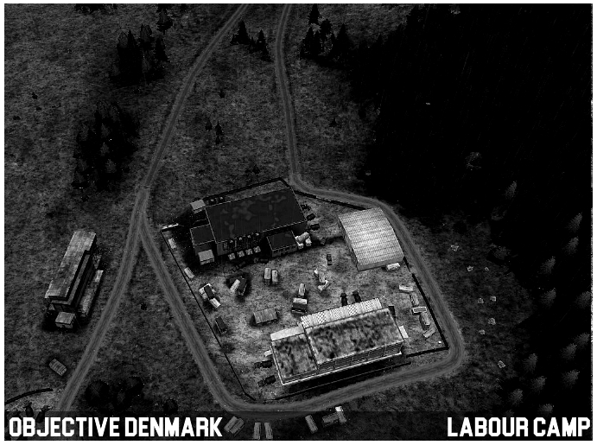
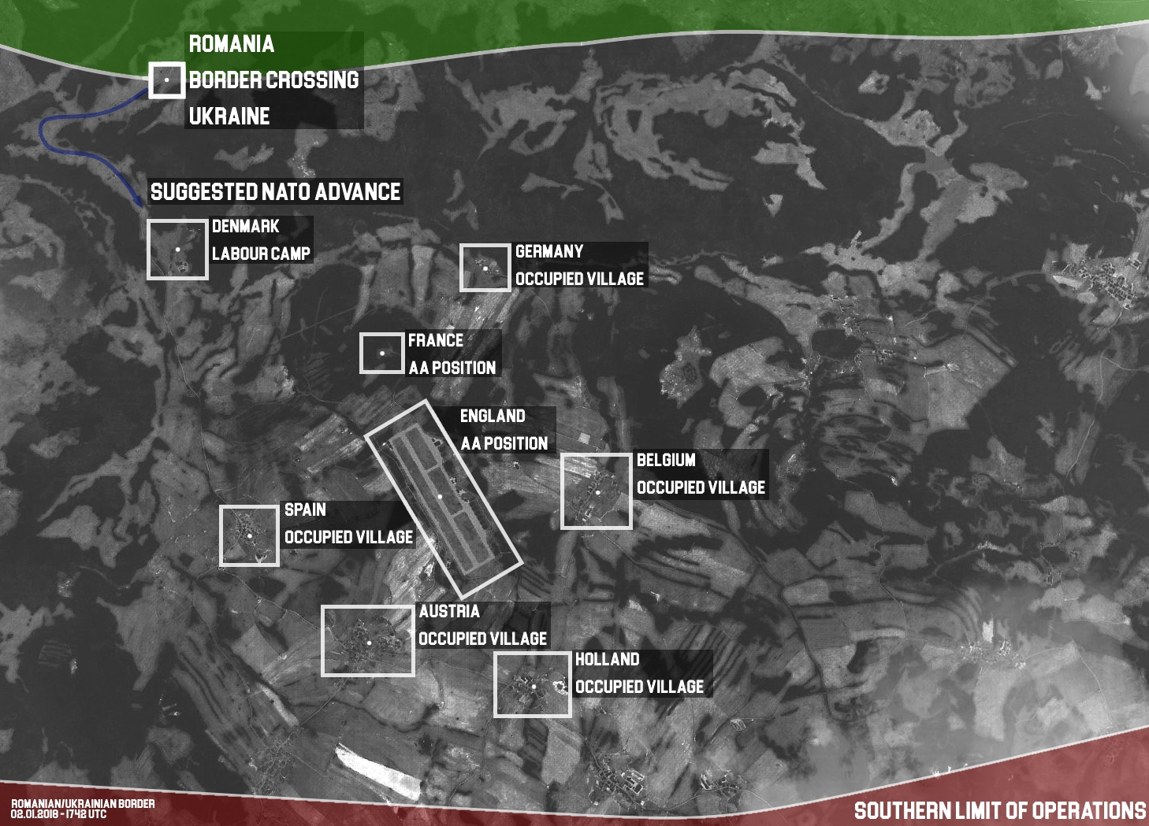
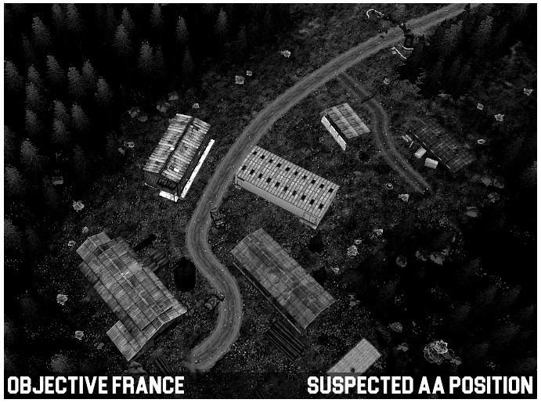
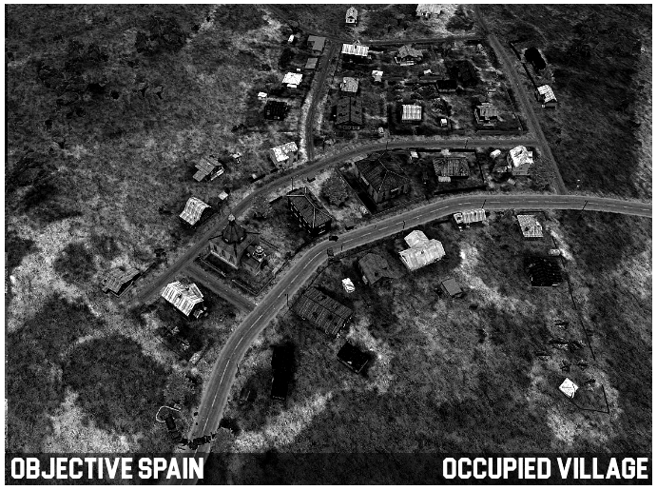
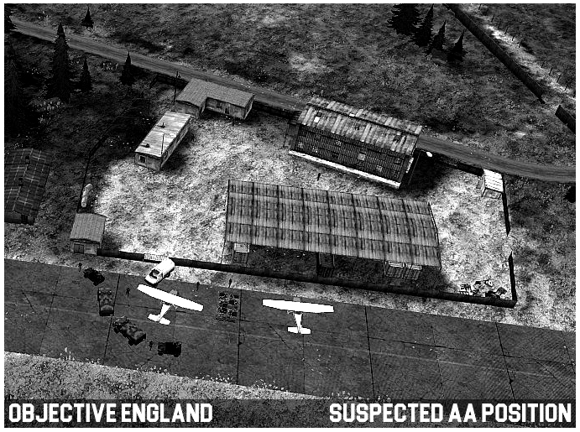
Operation: SHADOW BEAR
Location: SOUTH ZARGORIA
UKRAINE
Date: FRIDAY 12 JANUARY
Time: 1800 UTC
INTEL

Slide 8
Operation: SHADOW BEAR
Location: SOUTH ZARGORIA
UKRAINE
Date: FRIDAY 12 JANUARY
Time: 1800 UTC
END OF BRIEF
Please indicate your attendance on the post. The server password will be: SagaBegins
Classification: SECRET
Area: UKRAINE

